Slide 1
CollegeX
22AG1A05D2-B.Yashika
22AG1A05G6-Rama Sai Kiran
22AG1A05F7-Manideep

Slide 2
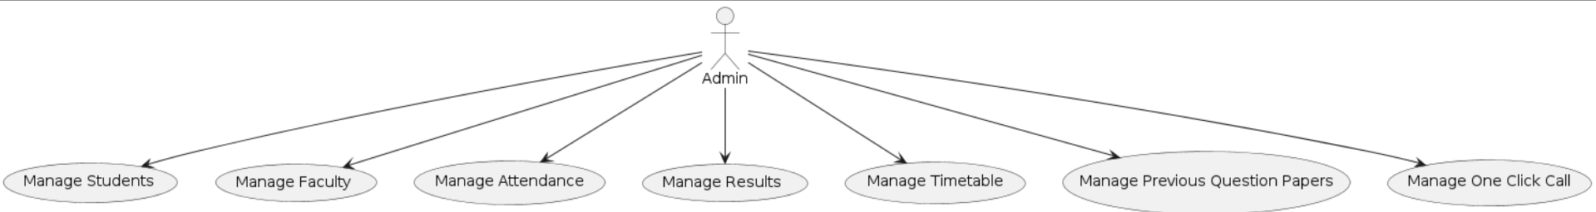
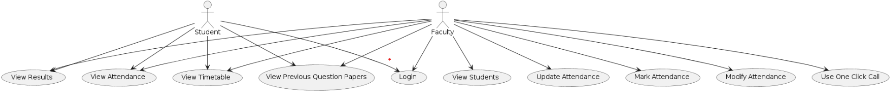
Use Case Diagram

Slide 3
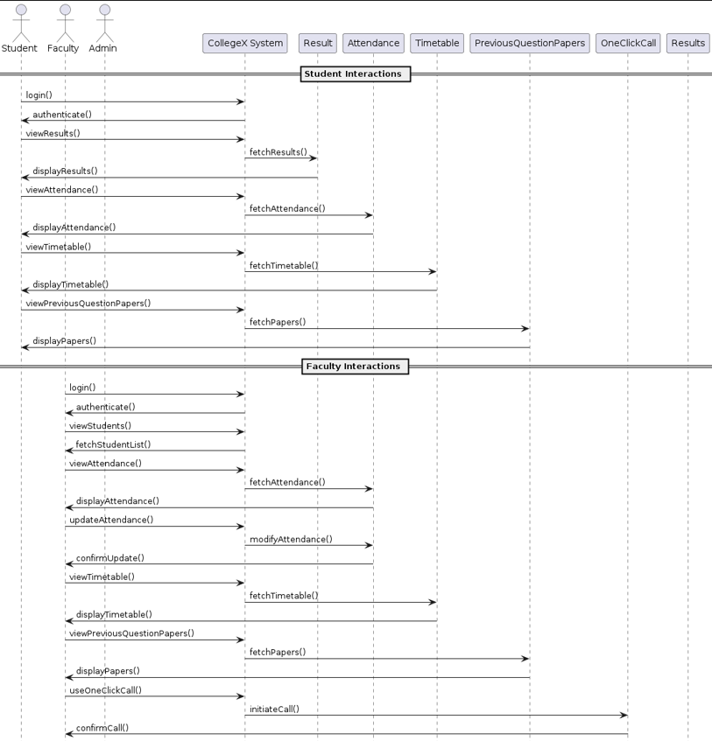
Sequence Diagram

Slide 4
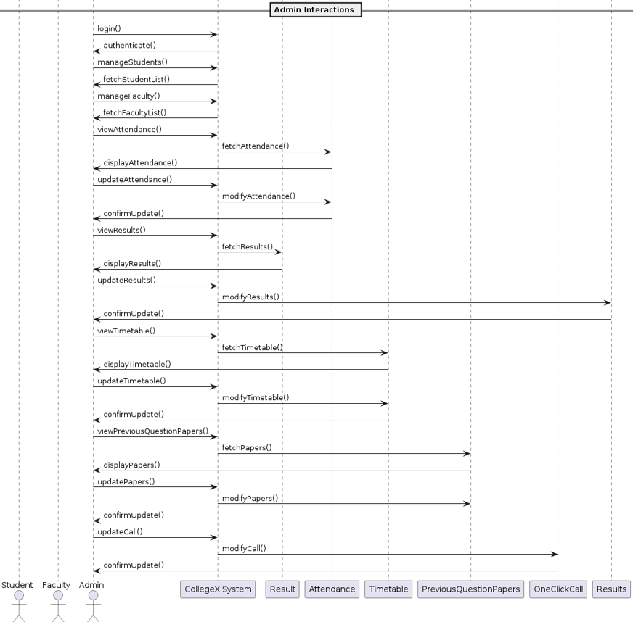
Sequence Diagram

Slide 5
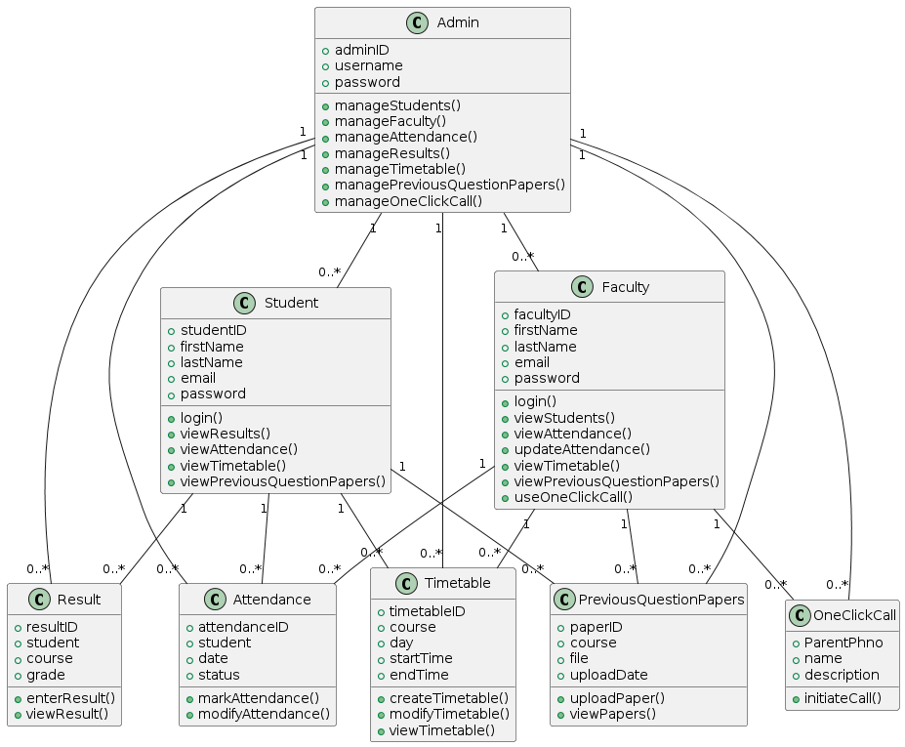
Class Diagram

Slide 6
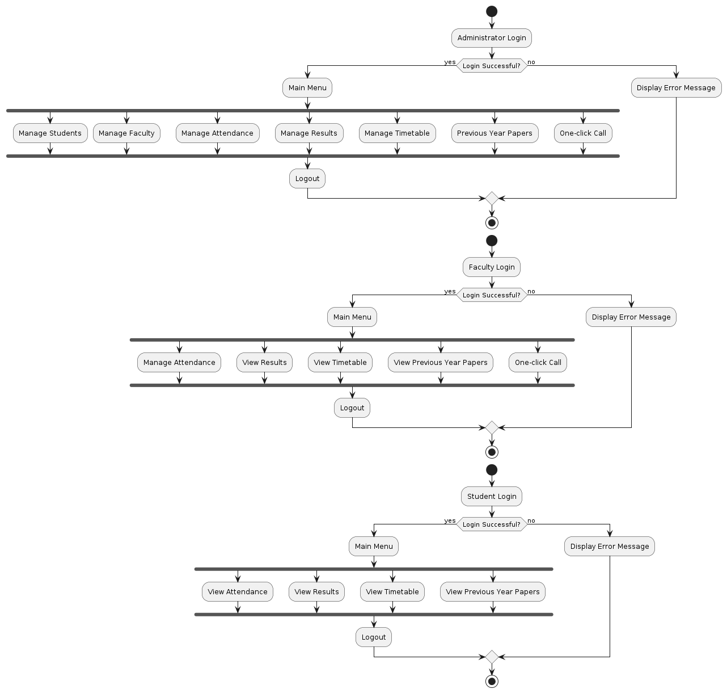
Activity Diagram

Slide 7
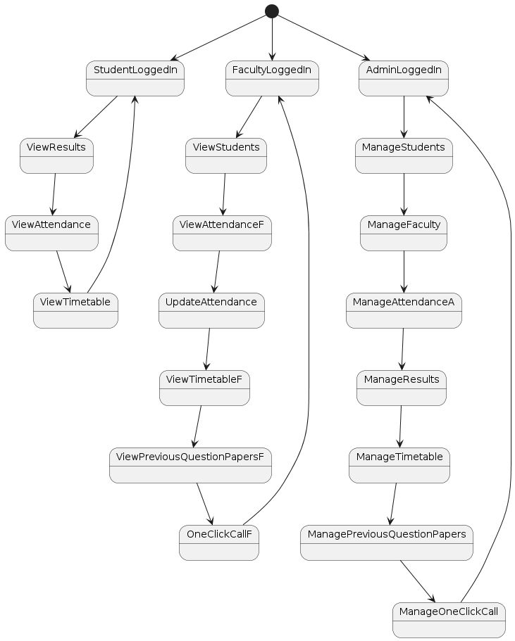
State Diagram

Slide 8
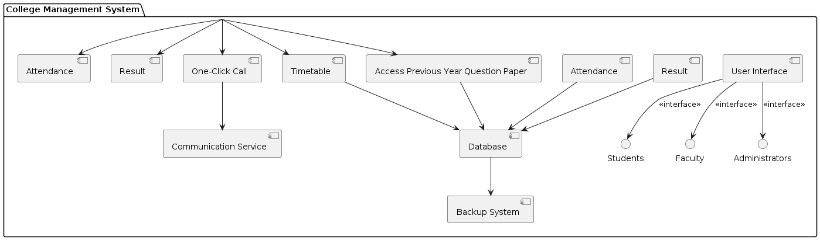
Component Diagram

Slide 9
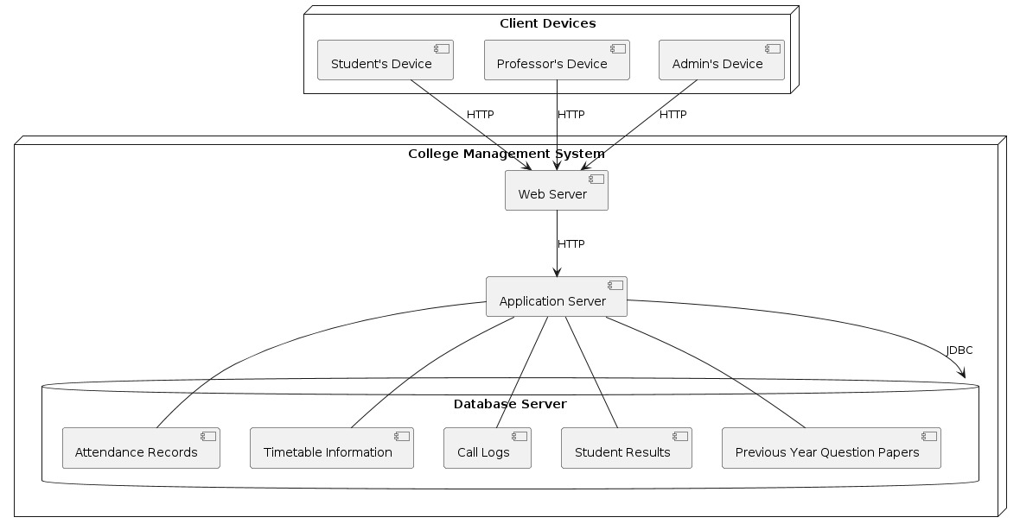
Deployment Diagram

Slide 10
THANK YOU

